Slide 1
Markov Chain-Based Prediction of Salzburg’s Land Use Evolution
Yueyi Chen
5.5.2025

Slide 2
Background
Urbanization
agricultural transformation
infrastructure growth

Slide 3
Question and Objective
How can we accurately model
&
predict land use change in Salzburg?

Slide 4
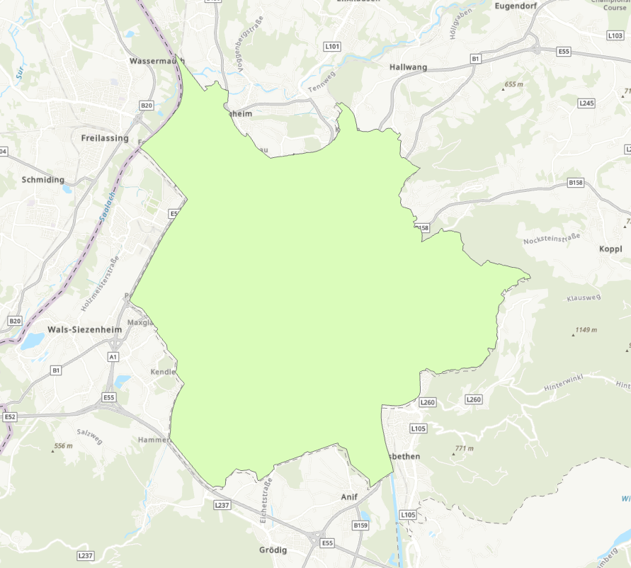
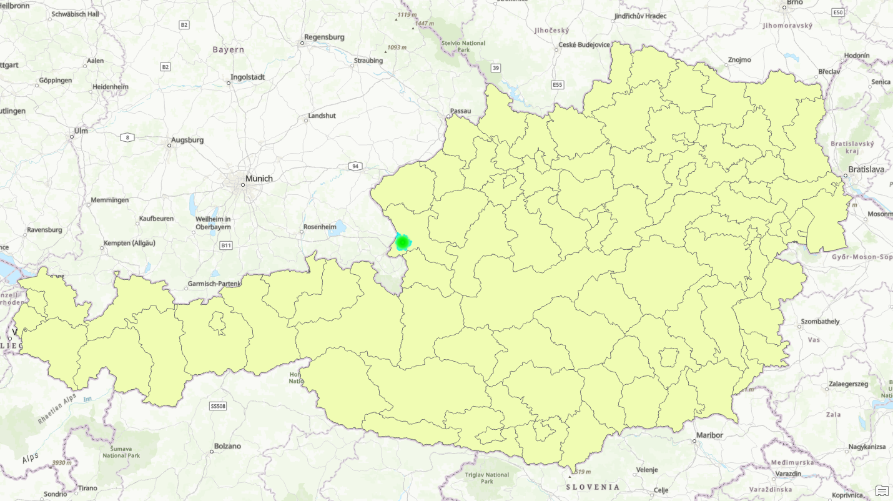
Study Area and Data
Salzburg

Slide 5
Land Use Classification

Slide 6
Driving Factors
City center
Stochasticity
Road
Slope
compactness

Slide 7
GAMA

Slide 8
Modeling Process

Slide 9
Calibration and Validation
Kappa statistics
spatial overlap indices

Slide 10
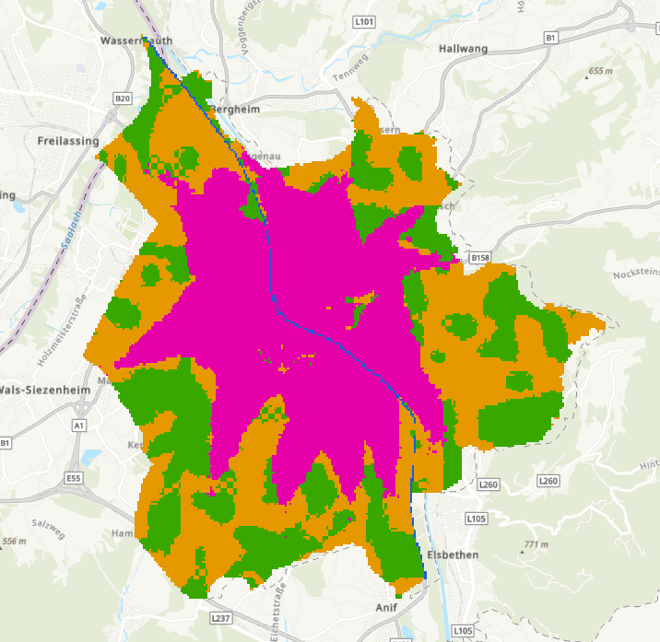
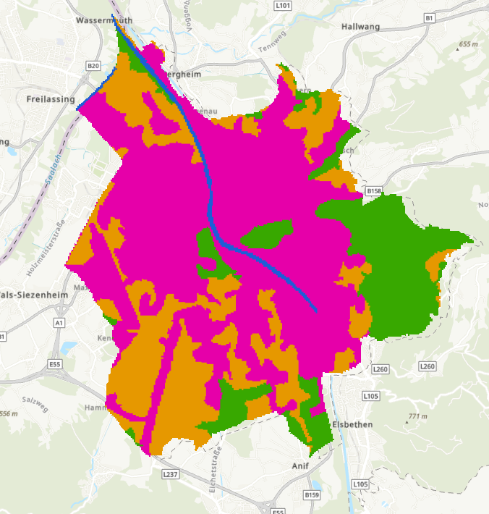
1990 Simulation vs Actual

Slide 11
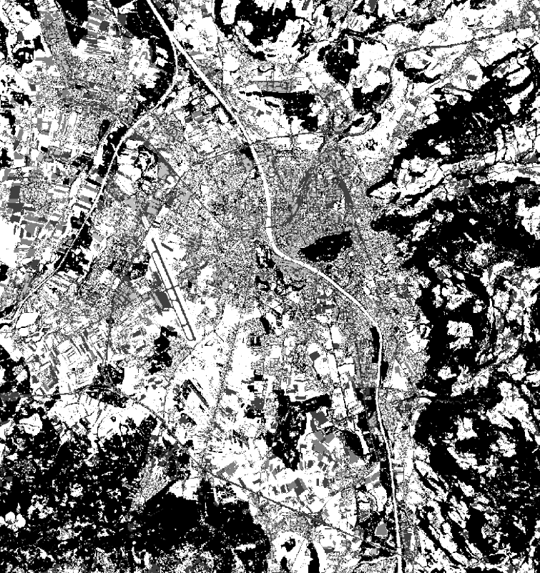
2024 Simulation vs Actual

Slide 12
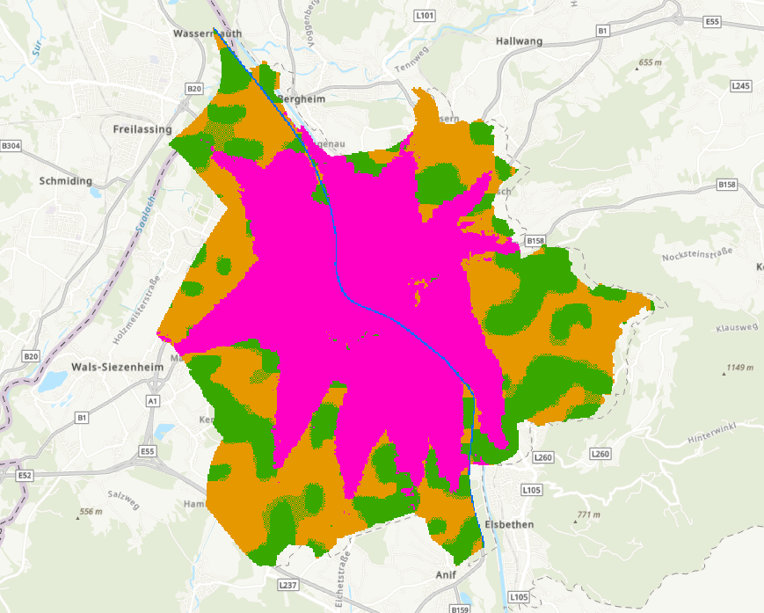
2030 Prediction

Slide 13
Overall Land Use Trends
Urban
River
Forest
Agriculture

Slide 14
Spatial Patterns of Change
Follow spatial patterns
Key roadways
Flat terrain

Slide 15
Model Applicability
Universal
&
Flexibility

Slide 16
Limitations and Errors
Resolution issues
Land categories
Data missing

Slide 17
Role of Drivers
Constrains Slope
Accelerate
Road proximity
Closeness to the city center

Slide 18
Comparison with Other Studies
⭐ Long-term historical data

Slide 19
Outlook
Socio-economic variables
Scenario modeling

Slide 20
Conclusion
Demonstrate
Predict
LULC changes in Salzburg from 1830 to 2030.

