Slide 1
Classifying Deciduous and Coniferous Forests with Deep Learning
Project Acronym: DeepForest
Author: Florian Herbst
06.05.2025

Slide 2
Why forest type classification?
Healthy forests are extremely important for climate stability
In times of climate change and extreme calamities in forests, now more than ever, good forest stewardship
Sustainable Forest Management requires accurate information about forests to supports risk management and decision making.
→ The required information includes the forest type (deciduous or coniferous).

Slide 3
Why forest type classification?
The forest type (dominant leaf type) informs:
Climate stability
Habitat for different species
Divergent vulnerabilities to pathogens
Different subsidies for forest owners

Slide 4
Why forest type classification?
Therefore, a system that can remotely classify deciduous and coniferous forests automatically, will be of great benefit for the forestry industry as well as government agencies.
The goal is to establish a small-scale, lightweight deep learning model, considering that this would be advantageous to efficiently leverage computing resources
This ensures, that a high repetition rate in classification is achievable and financially viable.

Slide 5
Research Question
It is not clear, whether a small-scale deep learning model can achieve classification of deciduous and coniferous forests with adequate accuracy.
Can light weight deep learning models reliably classify deciduous and coniferous forests from medium resolution satellite imagery?

Slide 6
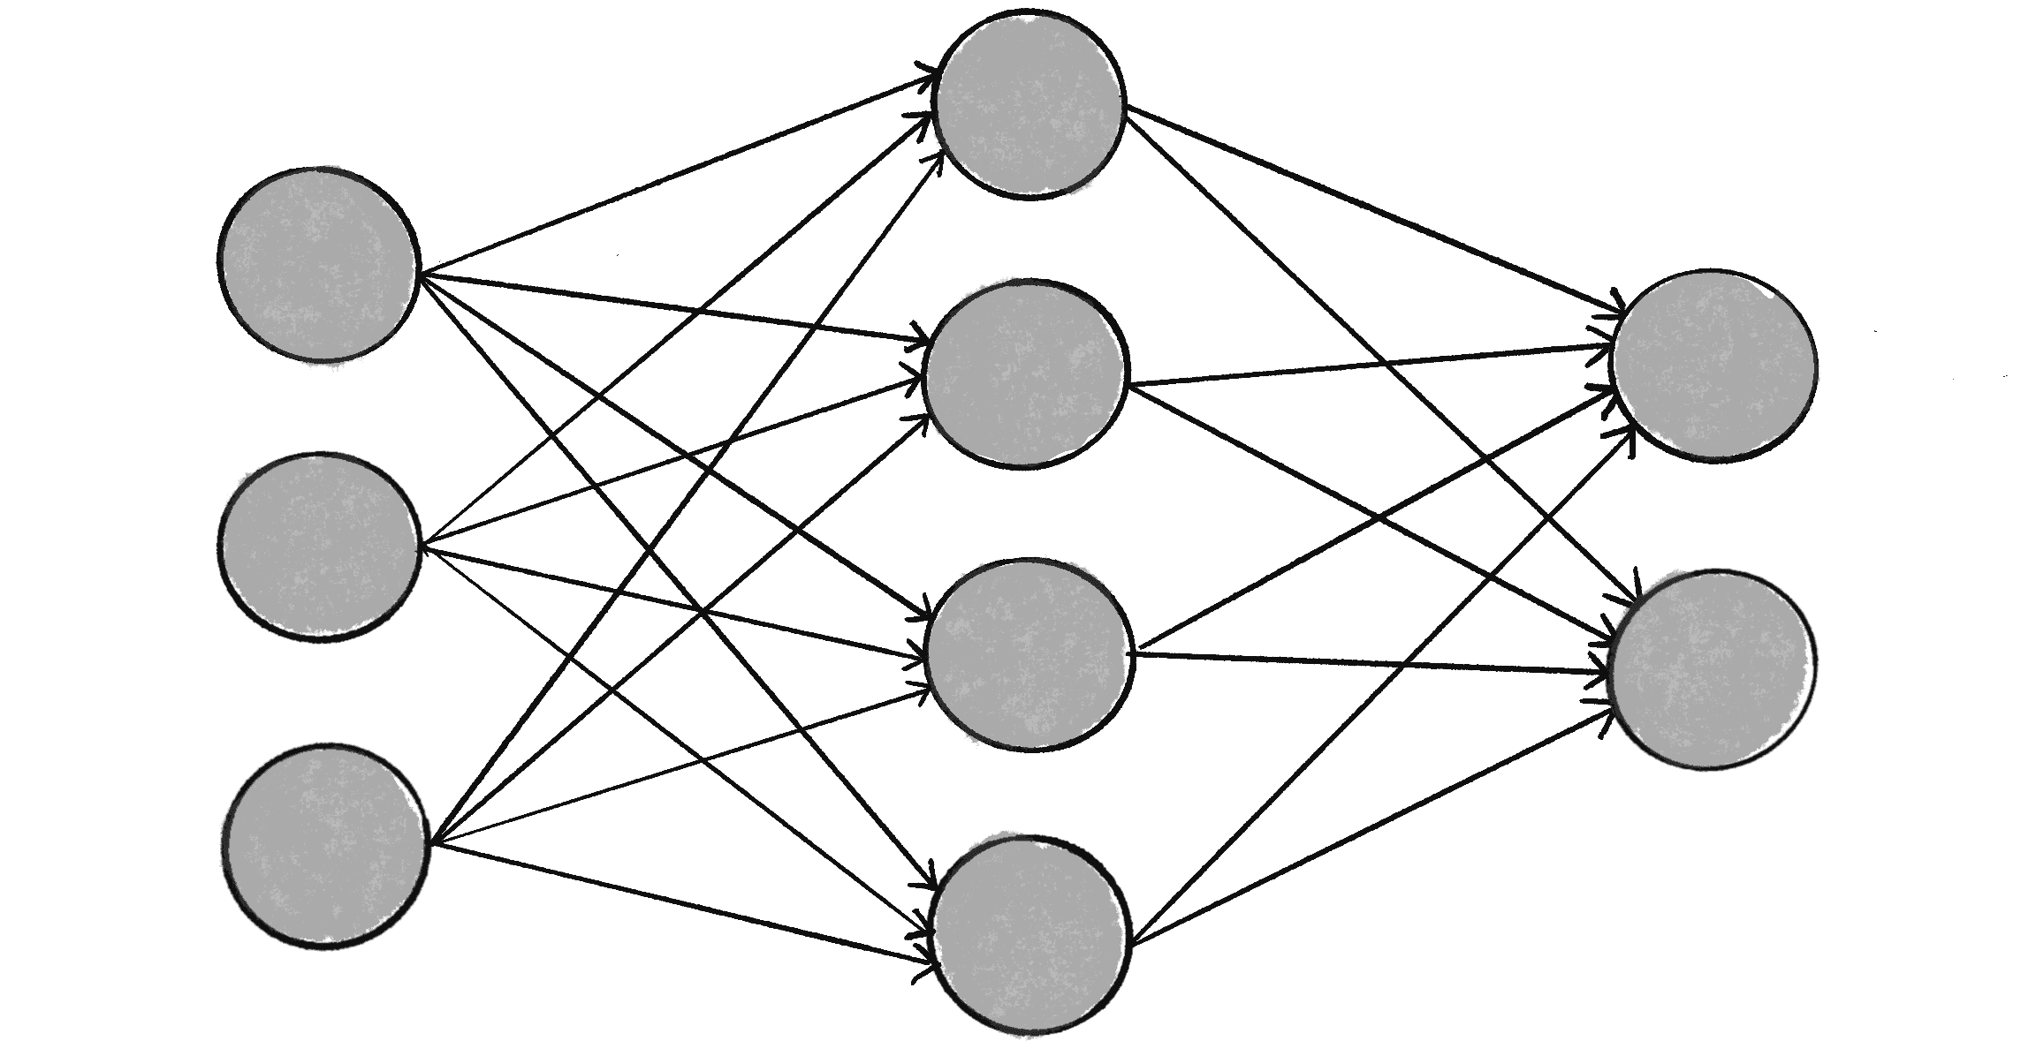
Main Objectives
CNN
Deciduous
Coniferous
Labeled Sentinel 2 Imagery

Slide 7
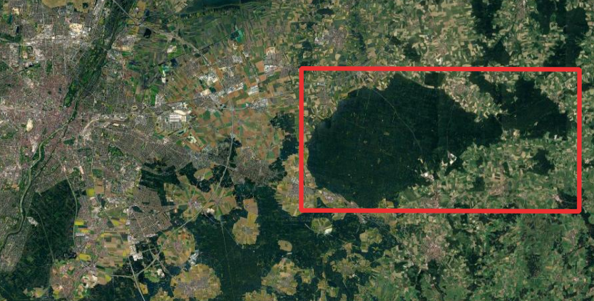
Case Study Area
AOI Ebersberger Forst
Munich

Slide 8
Data
Training Data
Sentinel-2 data (B2, B3, B4, B5, B8, B11)
Target Data
Dominant leaf type Copernicus Land Monitoring Service

Slide 9
Software
Google Colaboratory

Slide 10
Data Acquisition and Preprocessing Pipeline

Slide 11
Data Acquisition and Preprocessing Pipeline
Retrieve Data
Training-Data: Google Earth Engine Python API
Target-Data: Copernicus REST-API
Pipeline

Slide 12
Data Acquisition and Preprocessing Pipeline
Preprocess Data
These data are then perfectly aligned and clipped
Band resampling
Reprojecting
Clipping
Pipeline

Slide 13
Data Acquisition and Preprocessing Pipeline
Labeling
TIFF files are converted into NumPy Arrays
Tensorflow yields the arrays to the model
Model trains and validates on the arrays
Pipeline

Slide 14
Challenges
Perfect alignment of images
Pixel perfect accuracy

Slide 15
Model Architecture
Fully connected Networks can only handle one dimensional inputs
Flatten the image to one dimension
Spatial information is lost
Many, many parameters!
Every pixel is connected to every neuron in all layers

Slide 16
Model Architecture
Convolutional Neural Network
Preserves spatial information (Neighbourhood)
Image as 2D Array of pixel values

Slide 17
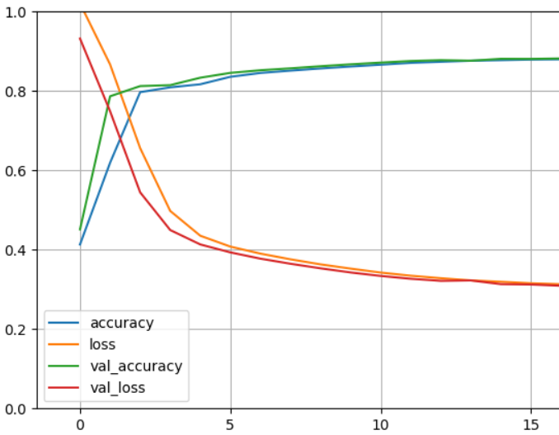
Evaluation
Validation phase
Testing phase
Overfitting
Confusion Matrix
Comparison

Slide 18
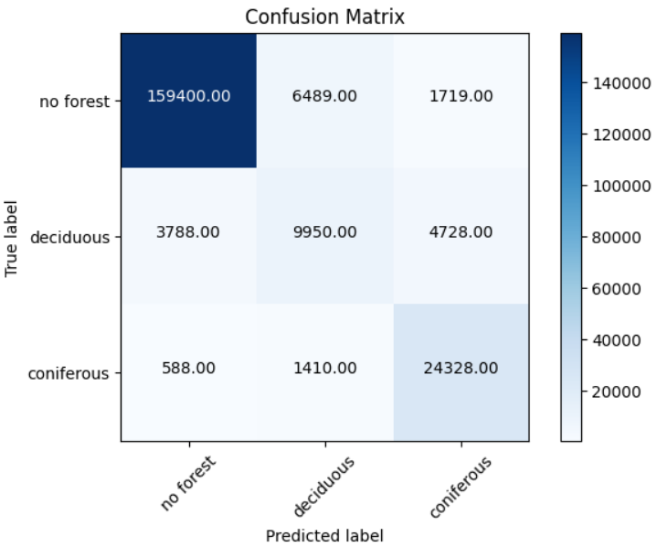
Evaluation
Confusion Matrix
Comparison

Slide 19
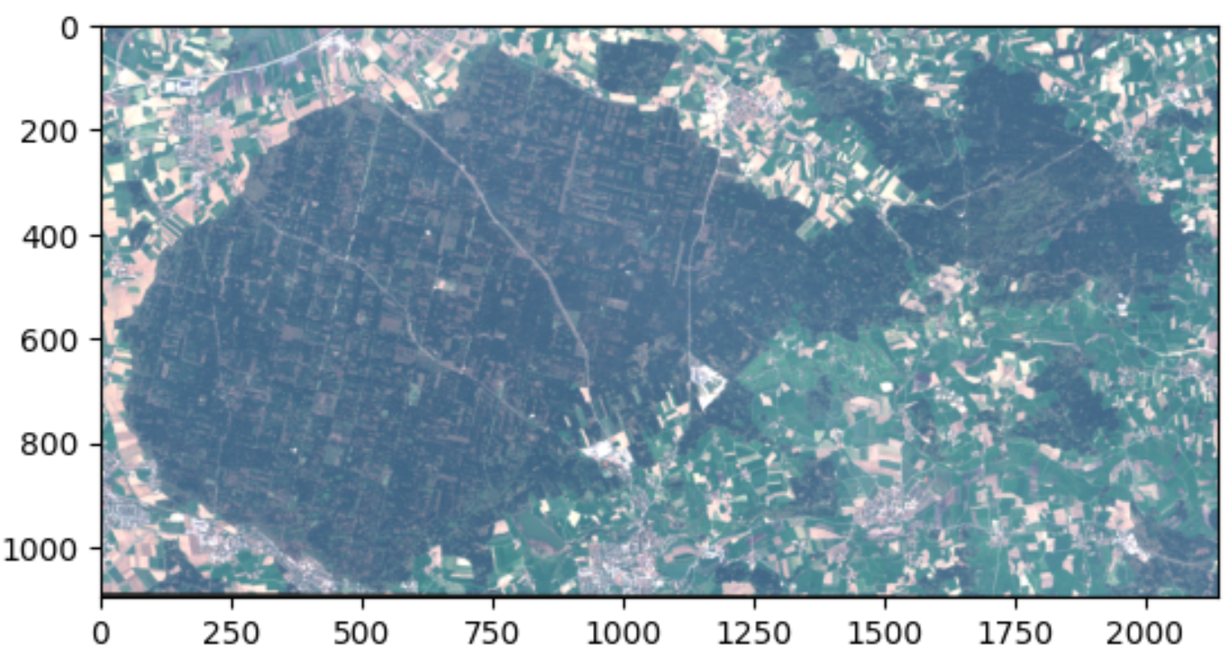
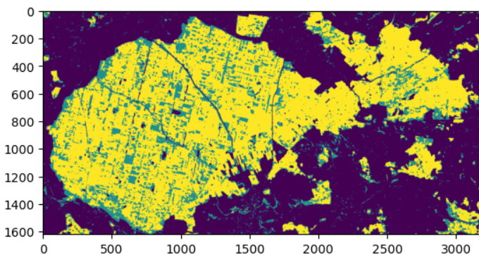
First Results

Slide 20
Discussion
Data preprocessing difficulties.
What is your experience with taster data preprocessing?

