Slide 1
The impact of
digitalization and green technologies
on wage gaps
in Europe
(Wage gap)
yiqi.liu@stud.plus.ac.at
2025/05/06

Slide 2
1 Introduction
Digital economy has become a key driver of global economic growth and transformation.
Background
Innovation in green technology improved ecological efficiency and achieve common progress in the economy, society and nature
Background
Industrial structure and labor market was impacted and further narrowed or widened the wage gap within the region
Research Question
How digitalization and green technology levels impact wage gaps in Europe
Hypothesis
Both digitalization and green technology will have an impact on wage gaps, but the impact on different regions differs
Cunyi Yang, C.Z., Khaldoon Albitar, ESG ratings and green innovation: A U-shaped journey towards sustainable development. Business strategy and the environmet, 2024. 33: p. 4108–4129.
Hao Zhang, F.J.J.-X.Y., Striking a balance between supply chain resilience and supply chain vulnerability in the cross-border e commerce supply chain. International Journal of Logistics Research and Applications, 2023. 26:3: p. 320-344.

Slide 3
1 Introduction
OBJECTIVE
OBJECTIVE
quantify the wage gap between European countries
use OLS and MGWR to explore the impact of digitalization and green technology levels on the wage gap in Europe
AIM
AIM
provide a reference for the decision-making of governments and enterprises
provide researchers with a new perspective

Slide 4
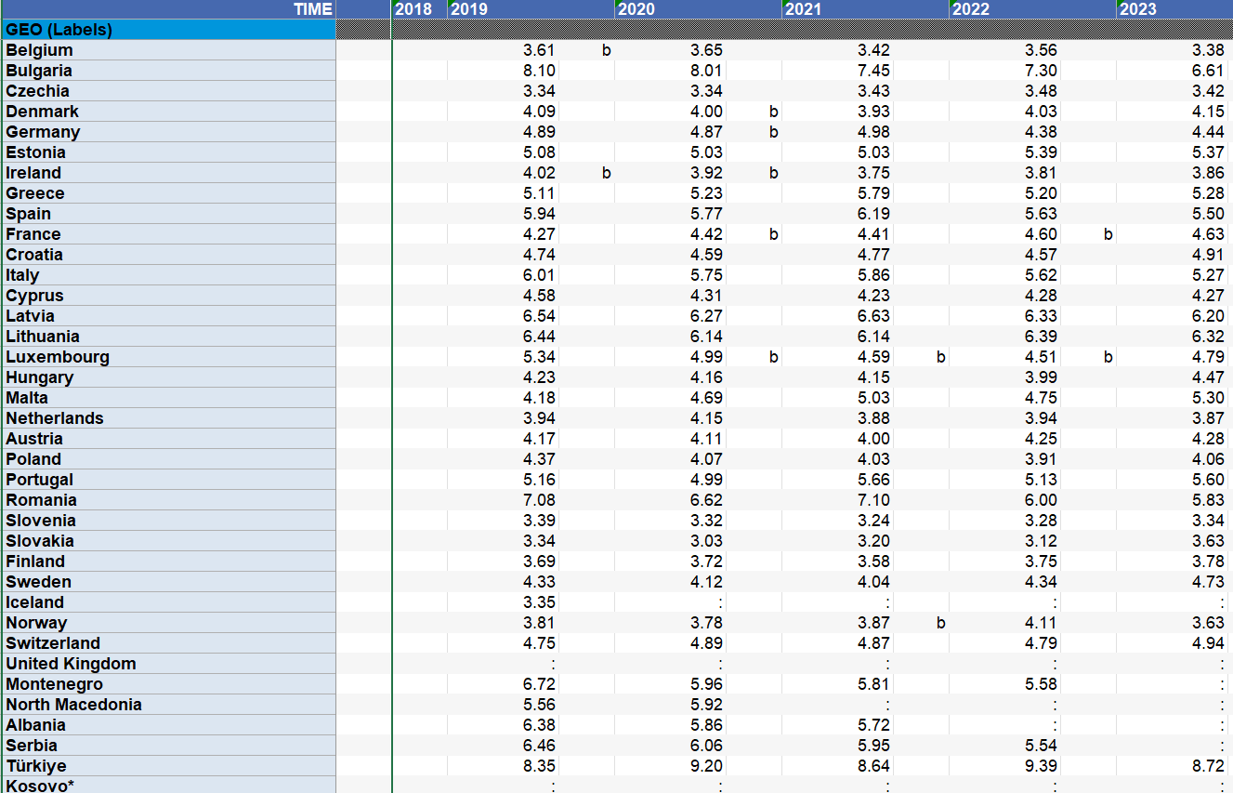
2 Indicators
wage gap
S80/S20
the ratio of total income received by the 20 % of the population with the highest income (the top quintile) to that received by the 20 % of the poorest population in 2023.
(Eurostat)

Slide 5
2 Indicators
digital level indicator
(Eurostat)
03
percentage of household that internet connection type is broadband
01
percentage of enterprise employed ICT specialists
04
percentage of enterprise provided training to their personnel to develop their ICT skills
02
percentage of enterprises that ICT functions are performed by own employees
Kexian Zhang, Hongmei Li . Spatial differences and convergence analysis of the development level of digital economy in urban agglomerations[J]. Economic Geography, 2022, 42(09): 120-128.

Slide 6
2 Indicators
adoption level of green technology
(Eurostat)
03
employment in the environmental goods and services sector
01
national expenditure on environmental protection
04
resource productivity
02
environmental protection investments of general government
Yinghao Zhang, Mingfeng Wang, Luming Cui , et al. The impact of digital economy level on green total factor productivity in Chinese cities[J]. Economic Geography, 2022, 42(09): 33-42.

Slide 7
3 Methods
Method1
Factor Analysis
Construct a digitalization and green technology indicator system
OLS
Preliminarily conduct analysis of influencing factors
Method2
Method3
MGWR
Conduct quantitative analysis of influencing factors

Slide 8
3 Formula
$$\text{Yi}\text{​=}\text{β}\text{0​+}\text{β}\text{1​}\text{X}\text{1}\text{i}\text{​+}\text{β}\text{2​}\text{X}\text{2}\text{i}\text{​+⋯+}\text{β}\text{k}\text{​}\text{Xki}\text{​+}\text{ε}\text{i}\text{​}$$
Yi​: Dependent variable (observation ii)
Xji​: j-th independent variable
β0​: Intercept term
β1​,…,βk​: Regression coefficients
The spatial econometric model Multiscale Geographically Weighted Regression (MGWR) is used to explore the spatial heterogeneity of impacts.
OLS
Ordinary least squares (OLS) is used to initially explore the impact of digitalization level and green technology level on wage gap.
MG
WR
$$\text{Yi}\text{​=}\text{β}\text{0​(}\text{ui}\text{​,}\text{vi}\text{​)+}\text{∑}\text{β}\text{j}\text{​(}\text{ui}\text{​,}\text{vi}\text{​)}\text{Xji}\text{​+}\text{ε}\text{i}\text{​}$$
Yi​: Dependent variable at location ii (coordinates ui​,vi​)).
Xji​: j-th independent variable at location ii
β0​(ui​,vi​): Location-varying intercept
βj​(ui​,vi​): Location-specific coefficient
εi​: Error term

Slide 9
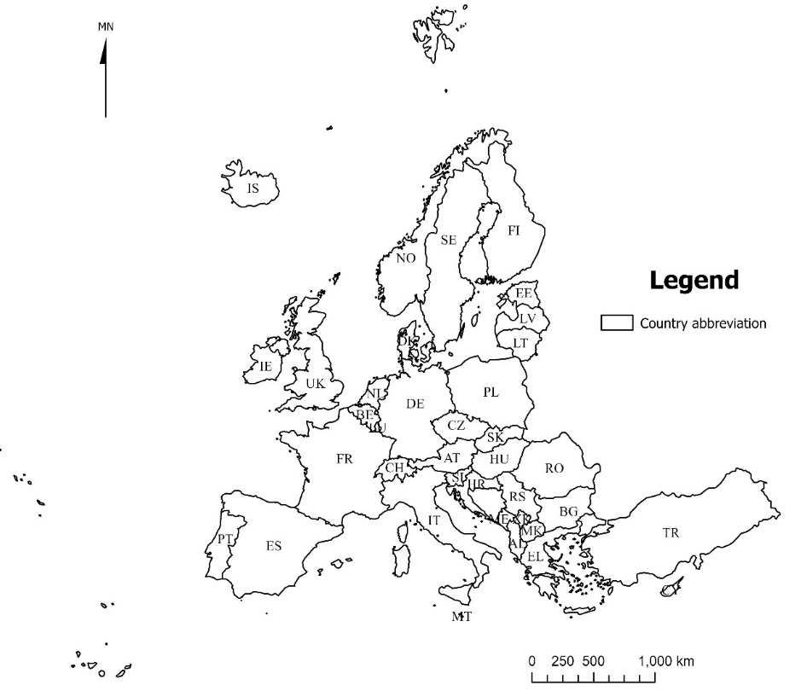
3 Study area
The research area of this study is Europe, mostly the European Union, a total of about 30 countries.
Due to missing data for some countries, the countries with available data for the digitalization level indicators and green technology level indicators are not exactly the same, and there are slight differences.
When using OLS and MGWR regression analysis, the impact of the digitalization level and green technology level on the wage gap were regressed separately, so the research areas of the two influencing factors are a little different.

Slide 10
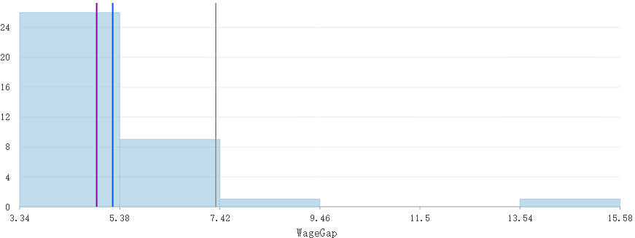
4 Results: Wage gap
Numerical
The mean of the wage gap in the study area is 5.24, the median is 4.91, and the standard deviation is 2.10. It can be seen that the wage gap in Europe is mostly between 3 and 5. Among them, Belgium has the smallest wage gap, only 3.38, while Kosovo has the largest wage gap, 15.58. The overall income gap of European countries is small.

Slide 11
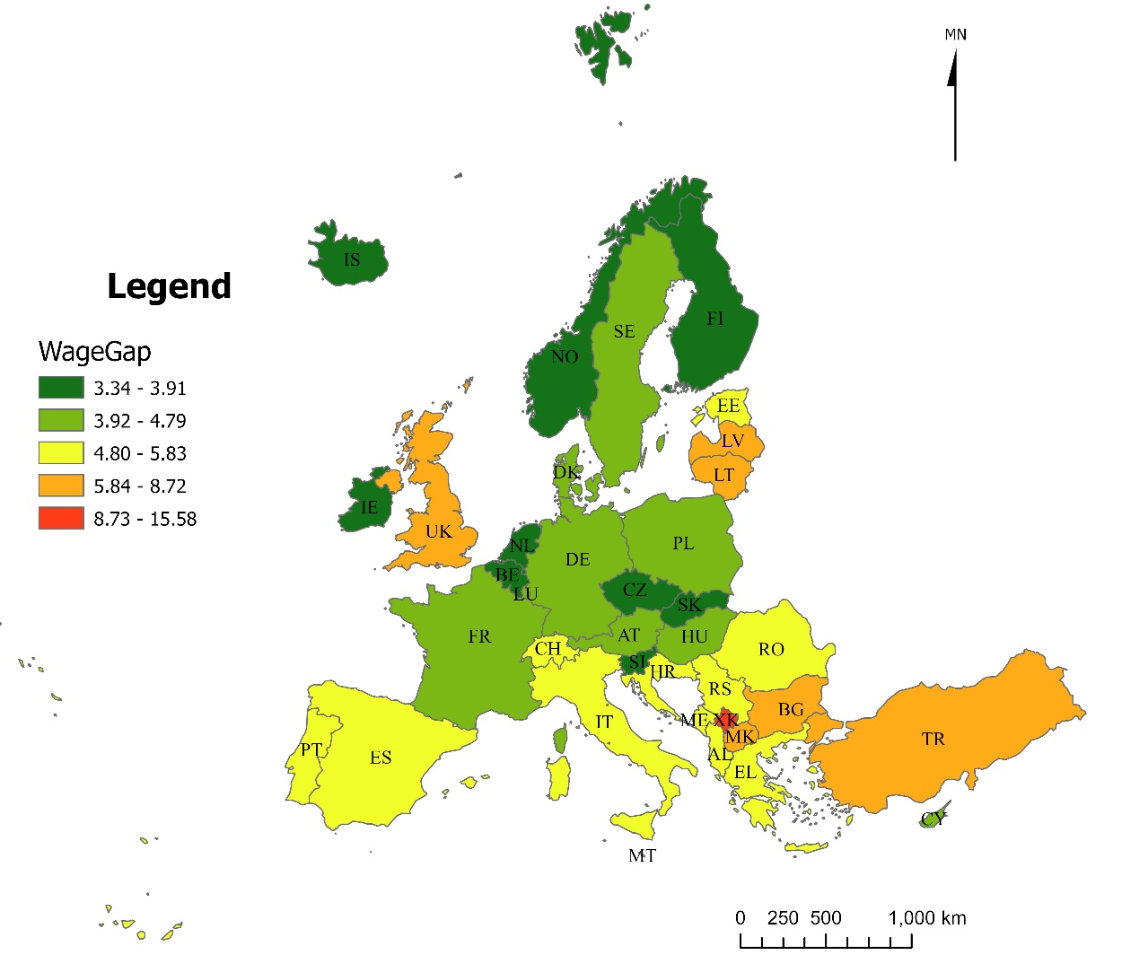
4 Wage gap
Spatial
In terms of space, the wage gap among European countries shows a pattern of “low in the north and high in the south, low in the west and high in the east”.

Slide 12
4 Wage gap
Spatial autocorrelation analysis
The Moran index value of the wage gap was 0.096, the z score was 2.48, and the p value was 0.013 (＜0.05), indicating that the spatial autocorrelation was significant, which means that the spatial distribution of the wage gap is not random, but presents a spatial clustered distribution.

Slide 13
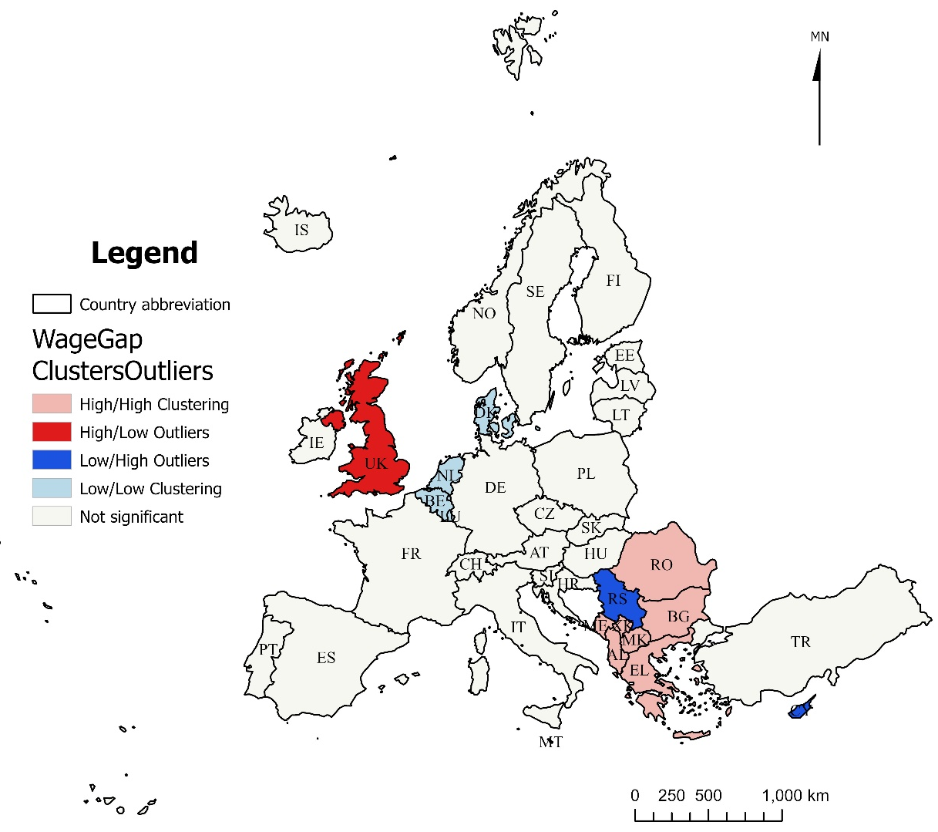
4 Wage gap
Clustering and outlier analysis
Belgium, Netherlands, Luxembourg and Denmark are low-value clusters of wage gaps.
Romania, Bulgaria, North Macedonia, Albania, Kosovo, Montenegro and Greece are high-value clusters of wage gaps.
The United Kingdom is an abnormally high value in the low-value area.
El Salvador and Cyprus are abnormally low values in the high-value area.
Wage gaps in Europe is clustered rather than randomly distributed.

Slide 14
4 OLS - Digitalization Level
Table 1 OLS results
The proportion of households with broadband Internet access and the proportion of enterprises providing ICT training have a significant impact on the wage gap.
The coefficient of two indicators is negative.
→ The two factors have negative impact on the wage gap.
Variable | Coefficient | Standard Deviation | Robust_Pr | VIF
proportion of companies employing ICT experts | -0.021183 | -0.811108 | 0.272317 | 1.665574
proportion of enterprise employees performing ICT functions | 0.018442 | 0.014643 | 0.113971 | 1.444524
proportion of households with broadband Internet access | -0.064889 | 0.030627 | 0.003312* | 1.339672
proportion of companies providing ICT training | -0.056827 | 0.025868 | 0.005536* | 2.436815

Slide 15
4 OLS – Green technology Level
Employment in the environmental goods and services sector and national expenditure on environmental protection have a significant impact on the wage gap.
The coefficient of national expenditure on environmental protection is negative.
→ it has a negative impact on the wage gap.
The coefficient of employment in the environmental goods and services sector is positive.
→ it has a positive impact on the wage gap.
Table 2 OLS results
Variable | Coefficient | Standard Deviation | Robust_Pr | VIF
national expenditure on environmental protection | -0.000028 | 0.000021 | 0.026234* | 5.249031
environmental protection investments of general government | -0.000056 | 0.000198 | 0.375582 | 2.862375
employment in the environmental goods and services sector | 0.000002 | 0.000001 | 0.00436* | 5.323579
resource productivity | -0.097738 | 0.087980 | 0.244563 | 1.177538

Slide 16
4 MGWR - Digitalization Level
Table 3 Coefficients of MGWR results
The proportion of households with broadband Internet access and the proportion of companies providing ICT training had significant impacts on wage gap, which were significant in 70% and 90% of the regions respectively.
The MGWR regression coefficients of two indicators are negative.
→ The proportion of households with broadband Internet access have a negative impact on the wage gap.
Variable | Average | Standard deviation | Min | Median | Max
proportion of companies employing ICT experts | -0.1228 | 0.0122 | -0.1411 | -0.1237 | -0.1006
proportion of enterprise employees performing ICT functions | 0.1078 | 0.0499 | 0.0443 | 0.1011 | 0.1968
proportion of households with broadband Internet access | -0.3421 | 0.0532 | -0.4203 | -0.3590 | -0.2249
proportion of companies providing ICT training | -0.4862 | 0.0488 | -0.5331 | -0.4998 | -0.3495

Slide 17
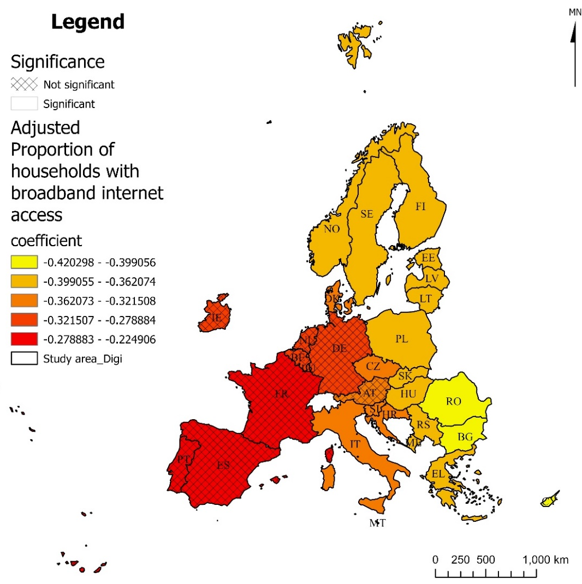
4 MGWR - Digitalization Level
The proportion of households with broadband Internet access
The proportion of households with broadband Internet access has a significant negative effect on Northern, Central, and Eastern European countries
The coefficient value decreases from west to east, indicating that the negative impact increases.
Reason:
The proportion of households with broadband Internet access represents the level of digital infrastructure construction in society.
The popularization of broadband promotes equal access to information.
The increase in its value means that more residents can obtain information, educational resources and job opportunities through the Internet.

Slide 18
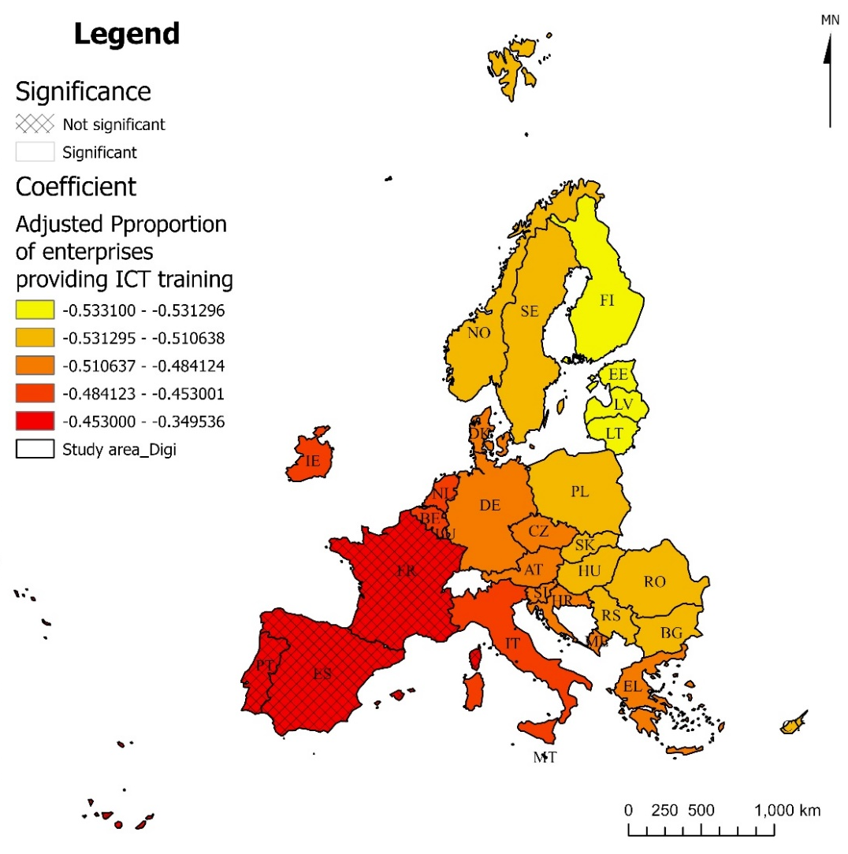
4 MGWR - Digitalization Level
The proportion of companies providing ICT training
The proportion of companies providing ICT training is significant for all countries except Spain, Portugal and France
The coefficient is also negative, indicating that the increase in the proportion of companies providing ICT training narrows the wage gap.
The impact of the proportion of companies providing ICT training on the wage gap is more significant in northwestern Europe than in southeastern Europe.
Reason:
Western Europe and Northern Europe have more high-tech companies and high-level labor that need ICT skills, so the increase in the proportion of companies providing ICT training has a greater impact on narrowing the wage gap in these countries.

Slide 19
5 Discussion
The wage gap shows obvious spatial differences. Generally speaking, it is lower in the North and West and higher in the South and East.
The improvement in the level of digital technology and green technology will have a negative impact on wage gap, and the extent of this impact varies in different regions.

Slide 20
5 Outlook
Remaining work:
Continue to complete the impact of green technology level on wage gap with MGWR
Organize experimental results in writing to prepare for writing papers
Problems:
Lack of comparison between OLS and MGWR regression results
The explanation for the spatial differences in impact is not sufficient
Solutions:
Compare the coefficients of OLS and MGWR regression and analyze the relationship and differences between their results
Obtain explanations for spatial heterogeneity by reading the literature

